Slide 1
NE 795-014: Advanced Reactor Materials
Fall 2023
Dr. Benjamin Beeler

Slide 2
Housekeeping
Reminder, test on Thursday on SFRs

Slide 3
molten salts

Slide 4
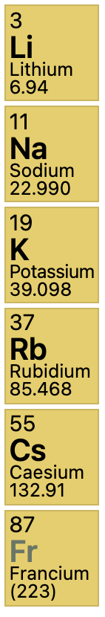
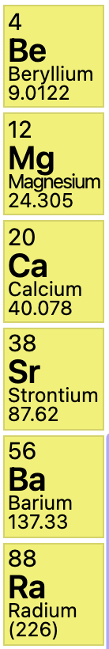
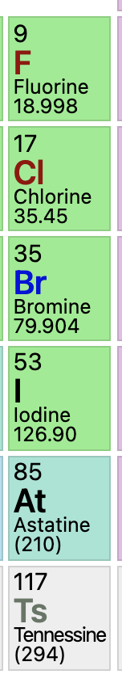
What are molten salts?
Alkali Metals
Alkaline Earths
Halogens
Salts are ionic compounds formed from a combination of electronegative and electropositive elements
At elevated temperatures salts liquefy and are termed “molten salts”
Halide salts are ionic compounds formed from the combination of a halogen (electronegative) and another electropositive element – commonly, but not exclusively, alkali metals or alkaline earths
Examples: LiF, BeF2, MgCl2, NaCl (aka table salt), ZrF4, RbF, UF4, UCl3

Slide 5
Molten Salt Reactors
Salt Cooled Reactor
Driven by some traditional fuel type in cladding, where the coolant is replaced with molten salt
Static Salt Fueled Reactor
The fuel itself is a liquid actinide-salt mixture contained in a cladding, often coupled with a salt coolant
Flowing Salt Fueled Reactor
The fuel itself is a liquid actinide-salt mixture which flows in a loops through the core and doubles as the coolant

Slide 6
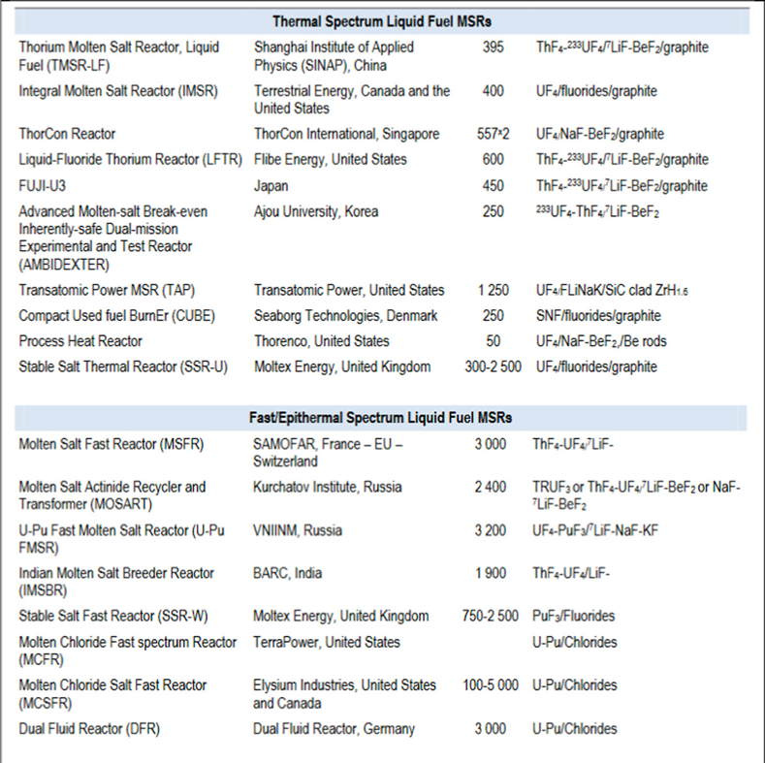
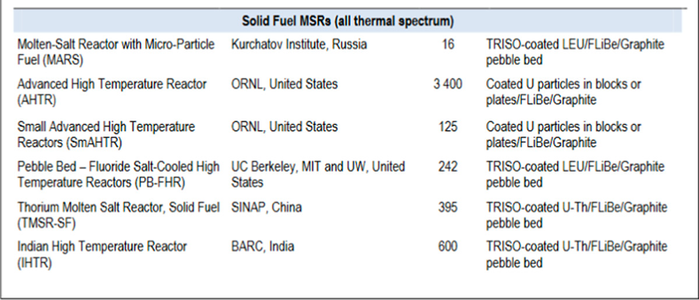
Thermal and Fast
Often salt reactors are further subdivided into fast and thermal spectrum reactors
List of examples of reactor systems with solid fuel, thermal liquid fuel, and fast liquid fuel

Slide 7
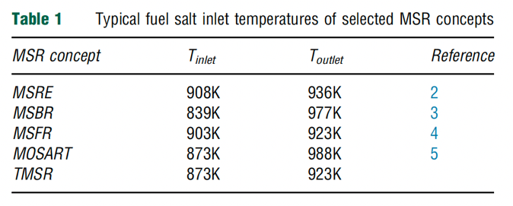
Benefits of MSRs
MSRs operate at or close to atmospheric pressure, rather than the 75-150 times atmospheric pressure of typical light-water reactors (LWR)
This reduces the large, expensive containment structures used for LWRs
Radioactive fission gases can be naturally absorbed into the molten salt
MSRs can have higher operating temperatures than a traditional LWR, providing higher electricity-generation efficiency, the possibility of grid-storage facilities, economical hydrogen production and, in some cases, process-heat opportunities.
MSRs have a strong negative reactivity feedback coefficient induced by the thermal expansion of the fluid
Backup safety measure of dump tanks for rapid removal of fuel
Possibility of online refueling and waste removal, plus benefits of reprocessing

Slide 8
Design/Nomenclature
When people usually refer to an MSR, they mean a thermal, fluoride-fueled, flowing loop reactor
This is due to historical reasons, as we will discuss
Thus, we have, unless otherwise specified: a liquid fuel with fission species dissolved in the salt; the fuel being pumped through and out of the reactor to a primary HX; secondary loop is typically also a molten salt and goes to a heat exchanger; tertiary loop is your steam turbine loop

Slide 9
Challenges of MSRs
The corrosivity of hot salts can break down cladding components and leech alloying elements
The changing chemical composition of the salt as it is transmuted by reactor radiation leads to changing properties
The processing of liquid transuranic molten salt fuel from the current spent fuel and of the on-line reprocessing of MSR fuel need to be solved

Slide 10
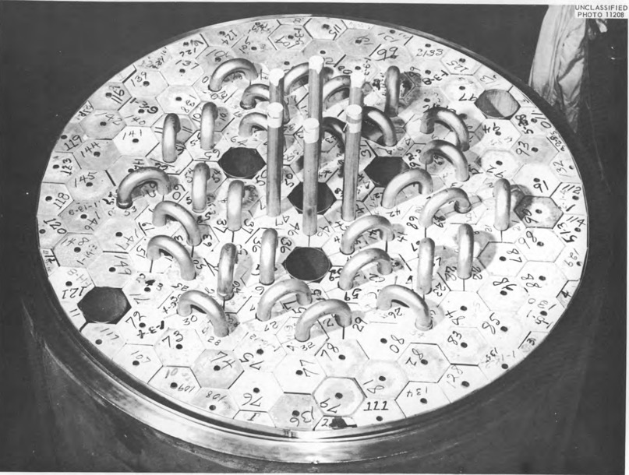
Beginning of MSRs
Aircraft Reactor Experiment (1954) was a 2.5 MWth thermal-spectrum nuclear reactor experiment designed to attain a high power density and high output temperature for use as an engine in a nuclear-powered bomber aircraft
It used the molten fluoride salt NaF-ZrF4-UF4 (53-41-6 mol%) as fuel, was moderated by a hexagonal-configuration beryllium oxide (BeO), and had a peak temperature of 860C

Slide 11
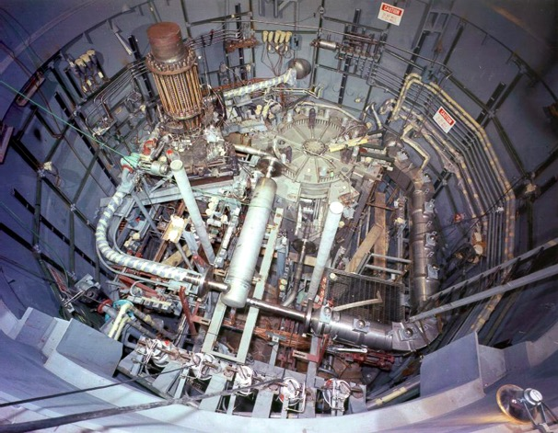
MSRE
The Molten-Salt Reactor Experiment (MSRE) was an experimental molten salt reactor at the Oak Ridge National Laboratory (ORNL); it went critical in 1965 and was operated until 1969

Slide 12
MSRE
MSRE was a circulating fuel type, utilizing LiF-BeF₂-ZrF₄-UF₄
The secondary coolant salt was LiF-BeF₂ (FLiBe), and the moderator was graphite
Salt-facing component were made of Hastelloy-N, which is a low chromium, nickel–molybdenum alloy

Slide 13
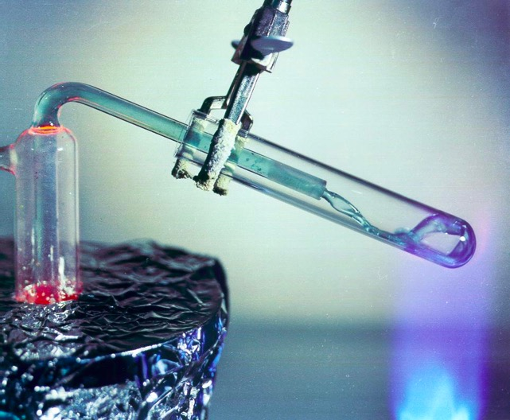
Fuel and Coolant Salts
A fuel salt is a molten salt that contains fissile material
Fuel salts consist of a mixture of some of all of the following:
Fissile material
Fertile material
Solvent (Lowers melting point, Decreases power density, Decreases viscosity)
Oxidation prevention material
Fission products
Coolant salts are molten salts with advantageous heat transfer properties

Slide 14
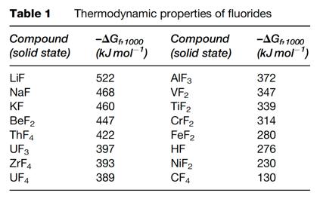
Fuel Salt Requirements
Low neutron absorption of non-fissile species
Radiolytic/thermal stability under in-core conditions
Dissolve fissile materials
High heat capacity, high boiling point, high thermal conductivity fluids
Melting point below ~525C
Low vapor pressure
Relatively insensitive to fission products
Both fluoride and chloride salts, under mildly reducing conditions, are reasonably compatible with high temperature structural alloys and graphite

Slide 15
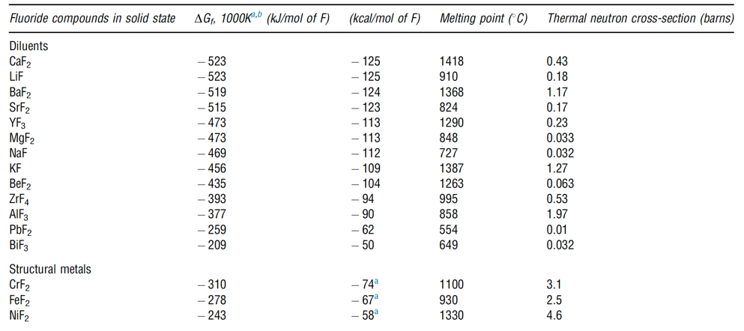
Solution Species
Solute species serve to lower the melting point, and can dually serve as an oxygen getter
Must have low neutron absorption cross section and be chemically compatible with cladding
BeF2, LiF, ZrF, and NaF are commonly utilized due to the combination of these properties

Slide 16
Fuel Salt Classes
Thermal spectrum reprocessing optimized fluoride salts
FLiBe (⁷LiF-BeF₂) and NaF-ZrF₄
FLiBe produces tritium, while NaF-ZrF₄ has a higher vapor pressure
Fast spectrum and thermal spectrum, once-through fuel cycle optimized fluoride salts
LiF-ThF₄-UF₄-(TRU)F₃
Much higher fissile loading (actinide-rich eutectics)
Adequate fissile material content is a significant design challenge
Chloride salts
Enables harder neutron spectrum and enhanced breeding
Isotopically separated chlorine preferable - ³⁵Cl from ³⁷Cl, due to moderate capture cross section of ³⁵Cl

Slide 17
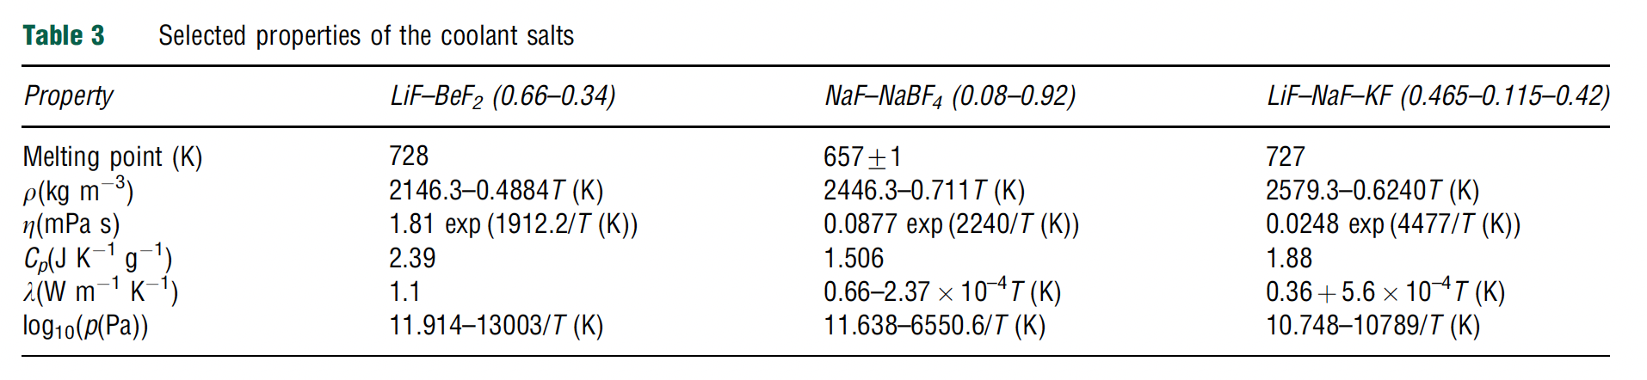
Coolant Salts
Coolants have the same requirements as fuel salts, but without the consideration of fission product solubility, and a higher focus on chemical compatibility and thermal properties
Some secondary systems also consider nitrate salts, such as NaNO3 and KNO3 or a mixture of the two, often referred to as solar nitrate; or fluoroborates such as NaF-NaBF3

Slide 18
Fluorides or Chlorides
Fluoride fuel salts have substantially more experimental data than chloride fuel salts, primarily due to history of MSRs in the thermal spectrum
Fluorides have been operated in molten salt reactors, been tested in multiple in-pile loops, with many capsule tests
Chloride salts have a history of laboratory measurements of physical properties, but no in-core testing of fuel salts
have extensive use in pyro-processing
Chlorides typically have lower melting points, which is preferable

Slide 19
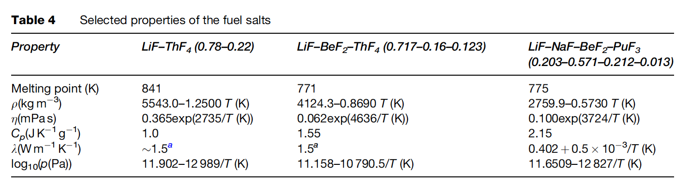
MSR Fuels
The fuel in the MSR must fulfill several requirements with respect to its physical and chemical properties
These include low melting point, high solubility of relevant species, low viscosity, high heat capacity, high thermal conductivity, low volatility/vapor pressure, neutron transparency

Slide 20
Neutron Economy
Thermal spectrum molten salt fuels were identified as candidates for breeding (converting fertile into fissile), specifically in the thorium fuel cycle
Li-Be-F salts were selected because of the low thermal neutron cross sections of ⁷Li (σ_{th} = 0.045 b) and Be (σ_{th} =0.0088 b)
Natural lithium cannot be used as part of the nuclear fuel as it contains about 7.6% of ⁶Li (the remaining 92.4% is ⁷Li), which has a very high parasitic neutron capture cross-section (σ_{th} = 940 b)
Therefore, enrichment of ⁷Li is required before it can be used in the core
Tritium production can become a problem without enrichment

Slide 21
Fast Spectrum MSRs
Current MSR designs move away from thermal graphite-moderated concepts, and favor non-moderated concepts that have a fast(er) neutron spectrum and can function to burn radioactive waste
Fuel selection for the non-moderated reactor concepts is more flexible, and elements other than ⁷Li can be considered
The neutron capture cross-section of the alkali halides and alkali-earth halides is generally lower in the fast spectrum than in the thermal spectrum
Compounds like NaF, KF, RbF, or CaF2 can be considered as part of the fuel matrix
There are also some fast MSR concepts which are based on chloride salts

Slide 22
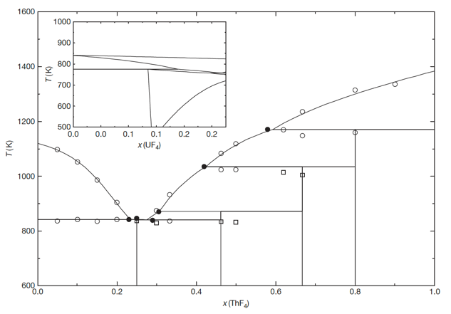
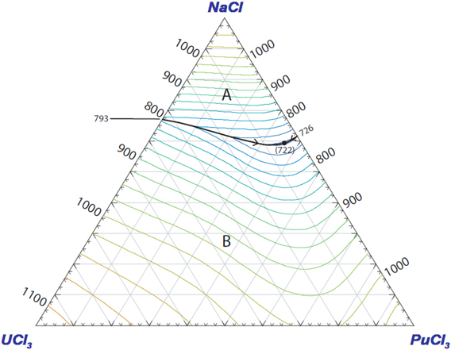
Solubility
The solubility of ThF4 in a matrix of LiF can be deduced from the binary phase diagram
For example, the solubility of ThF4 in a melt of LiF for T 903K (inlet temperature of the MSFR) is between 20.0 and 32.3 mol%
Compositions in this range are, thus, of interest as fuel for MSRs
Similarly, eutectic composition and melting temperature are key factors that govern the utilization of specific salts
Many fission products will form some kind of salt species, with varying degrees of solubility

Slide 23
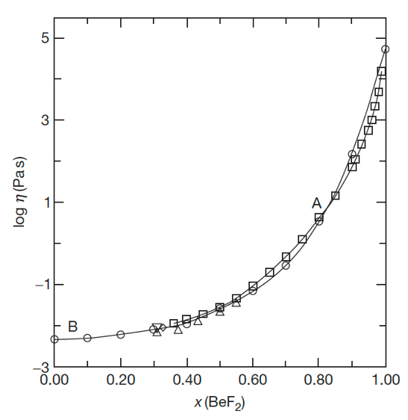

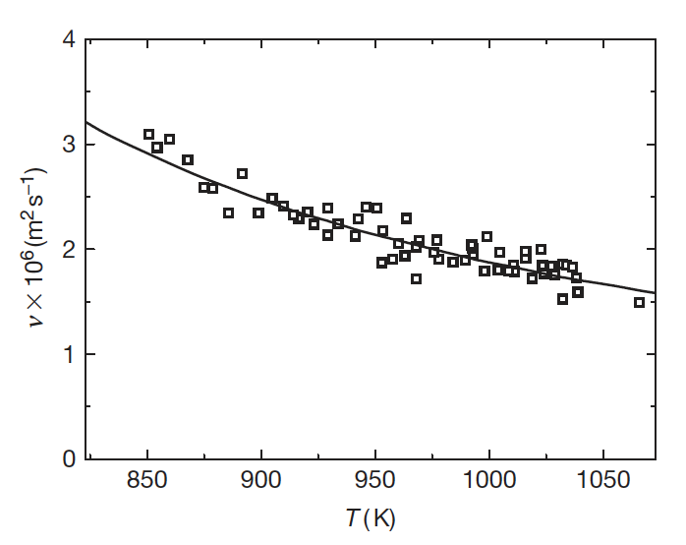
Low Viscosity
The viscosity of a fluid is a measure of its resistance to deformation at a given rate; conceptualized as the internal frictional force that arises between adjacent layers of fluid that are in relative motion
Lower viscosity results in less force to move the fluid at a given velocity
It is sometimes more convenient to utilize the kinematic viscosity, defined as the ratio of the dynamic viscosity μ to the density of the fluid ρ
The viscosity of fluoride systems shows significant non-ideal mixing behavior
Thus, it is not possible to accurately estimate the viscosity of the fluoride salts from its constituents, and therefore more measurements are required

Slide 24
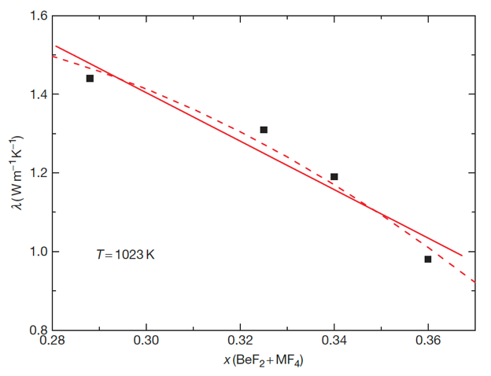
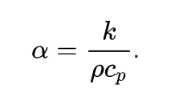
Heat Capacity and Thermal Conductivity
Heat Capacity is defined as the amount of heat to be supplied to an object to produce a unit change in its temperature
High heat capacity enables a small amount of the refrigerant to transfer a large amount of heat very efficiently
Data on experimental heat capacity and thermal conductivity of molten fluoride systems containing actinide fluorides are generally lacking
The thermal conductivity of a material is a measure of its ability to conduct heat
High thermal conductivity and thermal diffusivity will increase the rate of heat transfer through the fluid

Slide 25
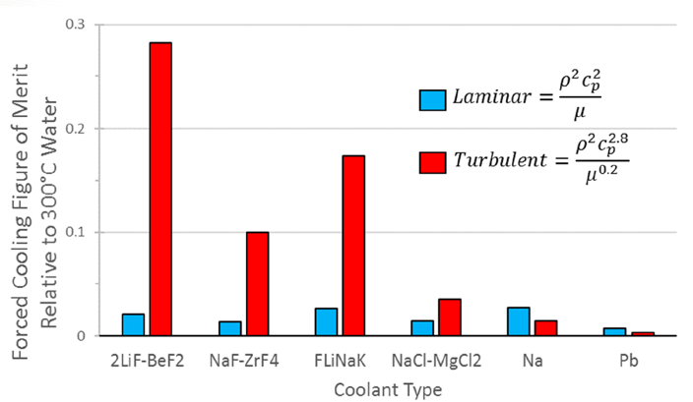
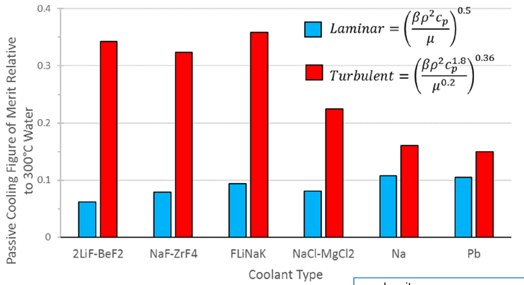
Heat Transfer
Large heat capacity and low viscosity are key properties allowing good heat transfer in molten salts
In both forced flow and passive cooling conditions, molten salts outperform liquid metals in turbulent flow for heat transfer
However, experimental data for heat transfer is still significantly scattered for the range of relevant MSR conditions

Slide 26
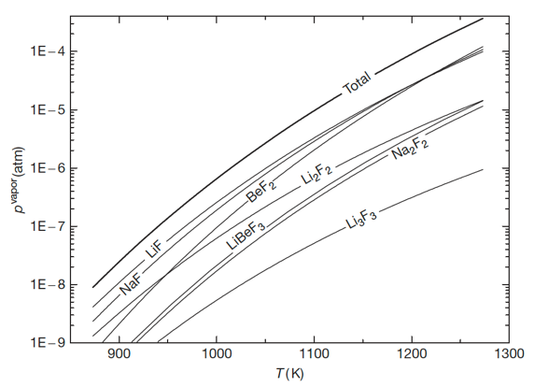
Vapor Pressure (Volatility)
Volatility is a material quality which describes how readily a substance vaporizes
A substance with high volatility is more likely to exist as a vapor, while a substance with low volatility is more likely to be a liquid or solid
Vapor pressure is a measurement of how readily a condensed phase forms a vapor at a given temperature
High vapor pressures indicate a high volatility, while high boiling points indicate low volatility
Salts should have high boiling and low freezing points, in addition to a low vapor pressure (low volatility)

Slide 27
Chemical Compatibility
For any high-temperature application, corrosion of the metallic container alloy is a primary concern
The products of oxidation of metals by molten salts tend to be completely soluble in the corroding media
Due to this solubility, passivation is precluded, and the corrosion rate depends on other factors, including oxidants, thermal gradients, salt flow rate, and galvanic coupling
Examination of the free energies of formation for typical alloy components shows that chromium is the most active metal component
Thus, any oxidative attachment to these alloys should be expected to show selective attack on the chromium
Stainless steels, having more chromium than Ni-based alloys, are more susceptible to corrosion by fluoride melts

Slide 28



Role of Oxygen Impurities
The behavior of these systems can be significantly affected by the presence of the oxygen that might be resulting from contamination of the salt system
Actinide oxides, such as UO2, can precipitate out for oxygen concentrations as low as 1E-4
Metal oxides have much higher melting points and therefore appear as insoluble components at operating temperatures
Oxygen also plays a key role in corrosion processes
ZrF4 was implemented as an oxygen getter in the original MSRE fuels
AlCl₃ or CCl₄ can also be used as reactants to tie up oxygen, or strip O from UO2

Slide 29
Summary
Molten salt reactors: intro and history
Fast and thermal; high temperatures; low pressures; flowing fuel salt with secondary salt loop
Fluorides and chlorides salts for different applications
Requirements for fuel salts: low melting point, good thermal conductivity, radiation/temperature stability, beneficial solution species, etc.
Talked through the concepts of a number of the properties of salts
Control of oxygen and redox conditions is critical to limit precipitation of the fuel and corrosion of the cladding

